Slide 1

Cloud DevOps
Project capstone
Part II
Nozim Khodjaev
March 11, 2021

Slide 2
agenda
• What is the “Project Capstone” and its the purpose?
• What technology will be utilized to make this project successful?
• Step-by-step walkthrough
•
• Challenges: What was done and what is still not achieved?

Slide 3
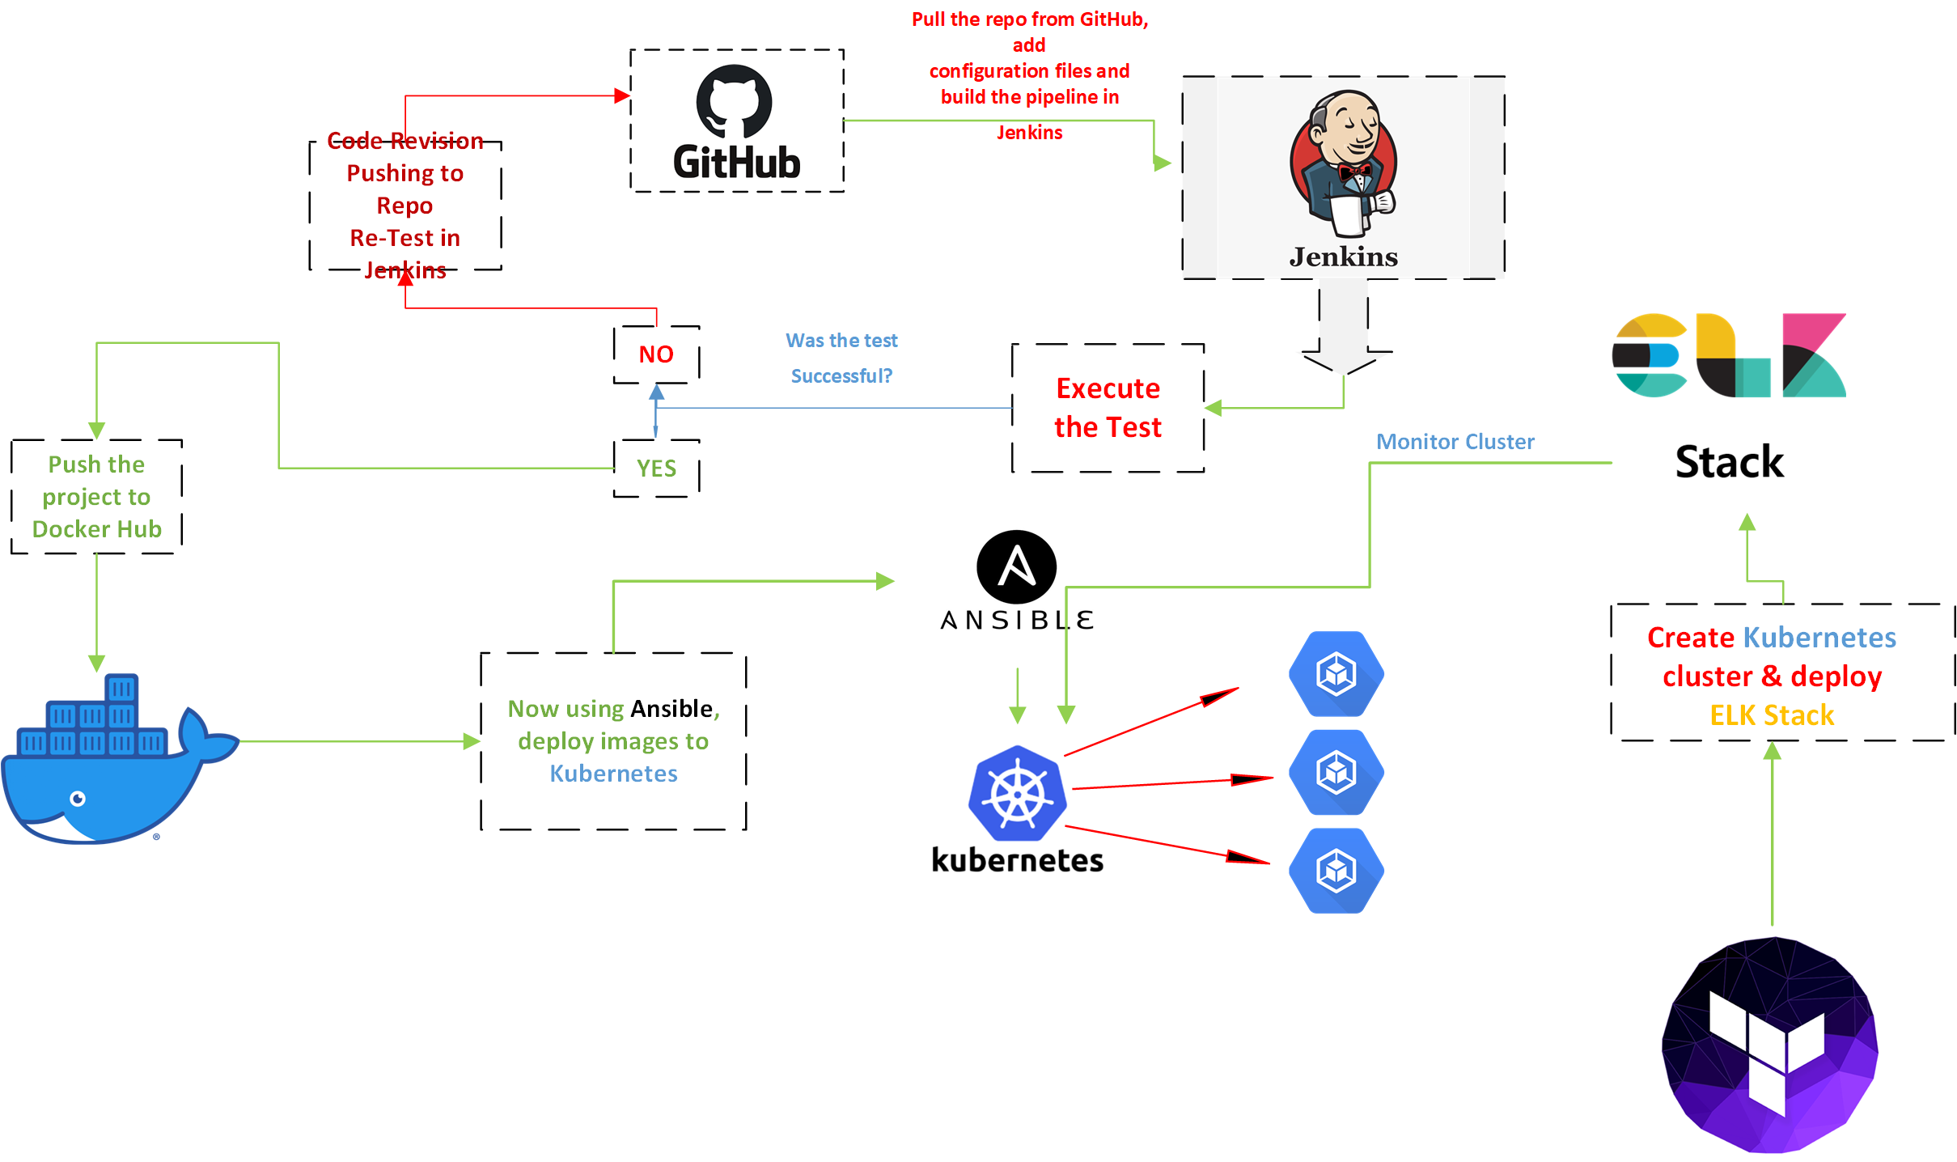

Slide 4
ENVIRONMENT SETUP
VM with following Software/Applications Installed:
• Jenkins
• Ansible
• Docker
• Terraform
• Kubernetes
• ELK Stack to monitor Docker
• Grafana to monitor Kubernetes

Slide 5
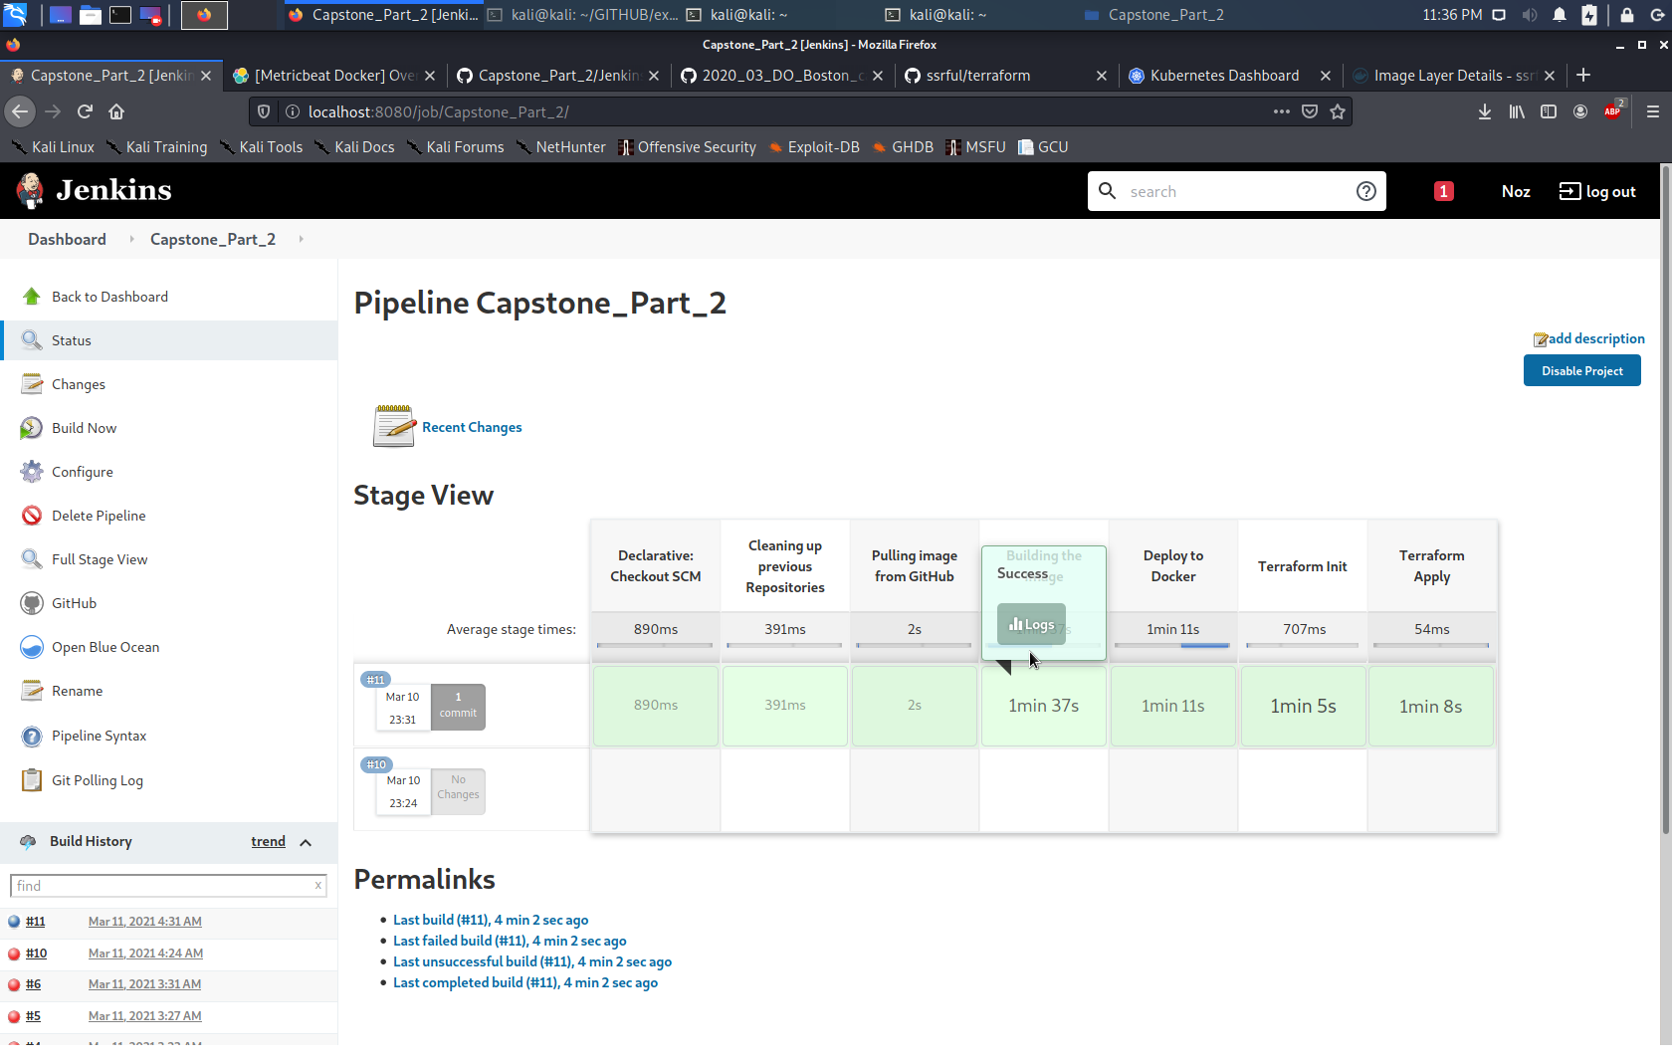
Jenkins
Running on docker

Slide 6
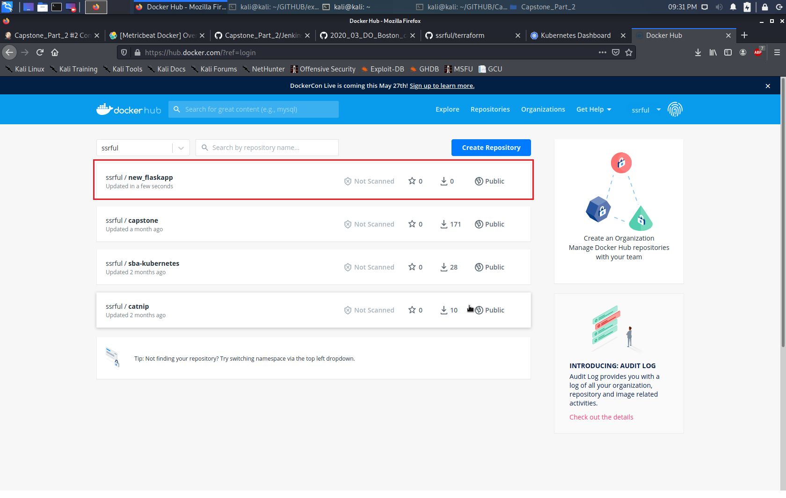

Slide 7
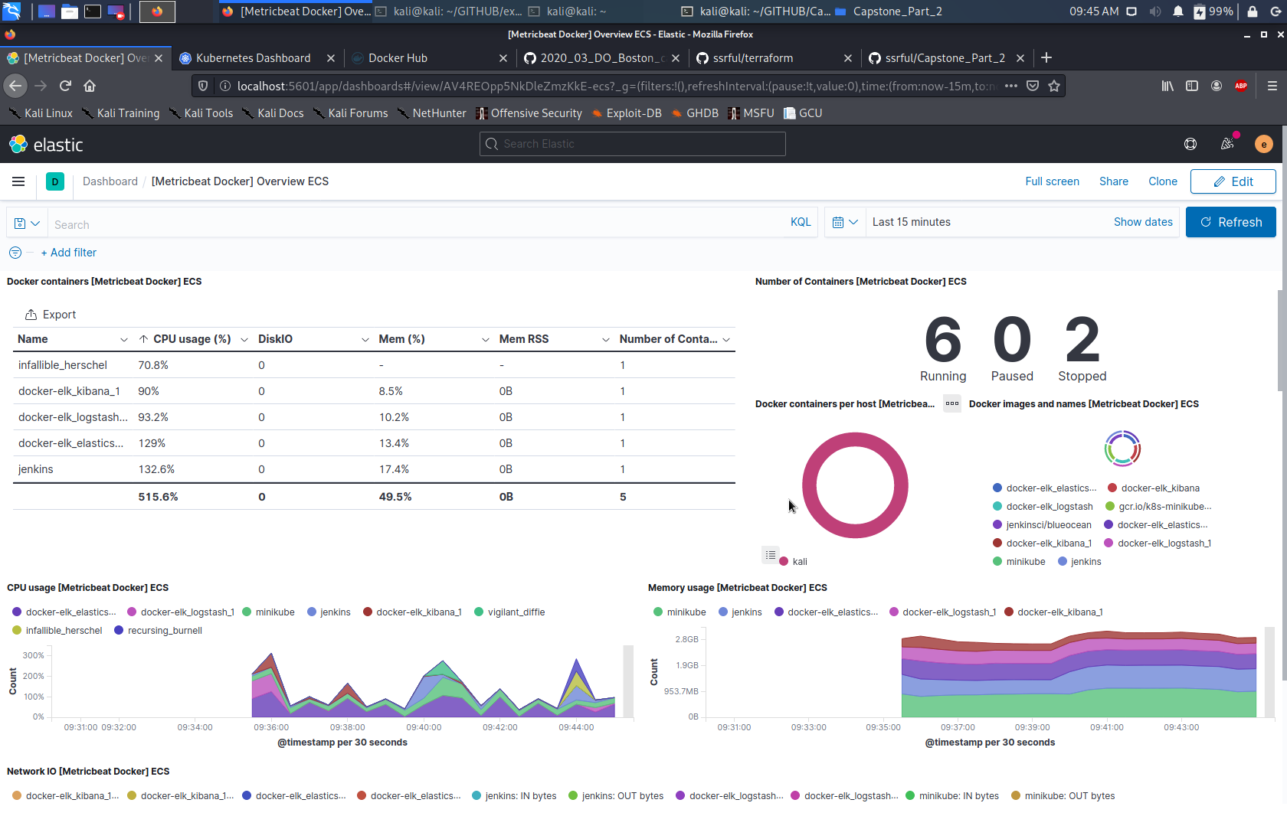

Slide 8
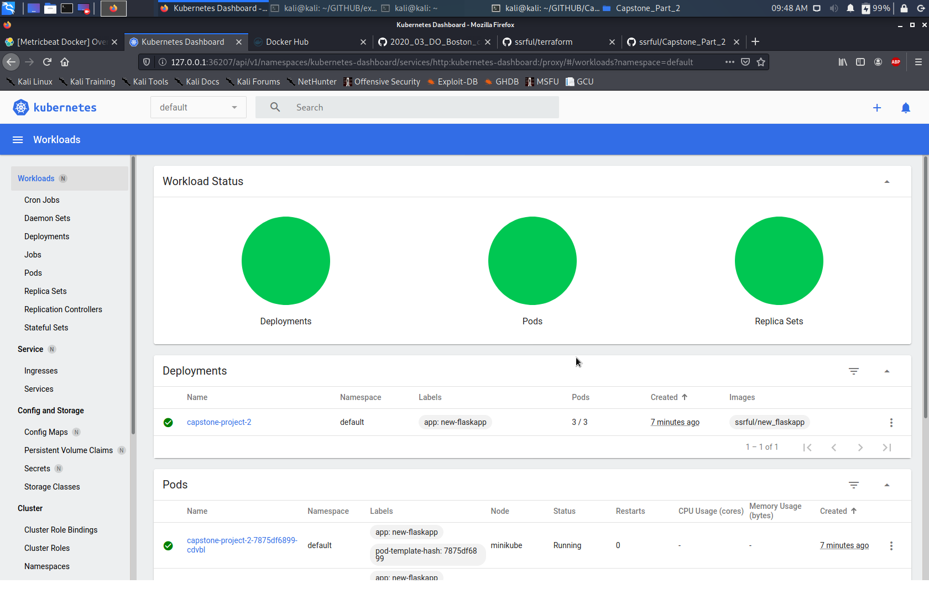

Slide 9
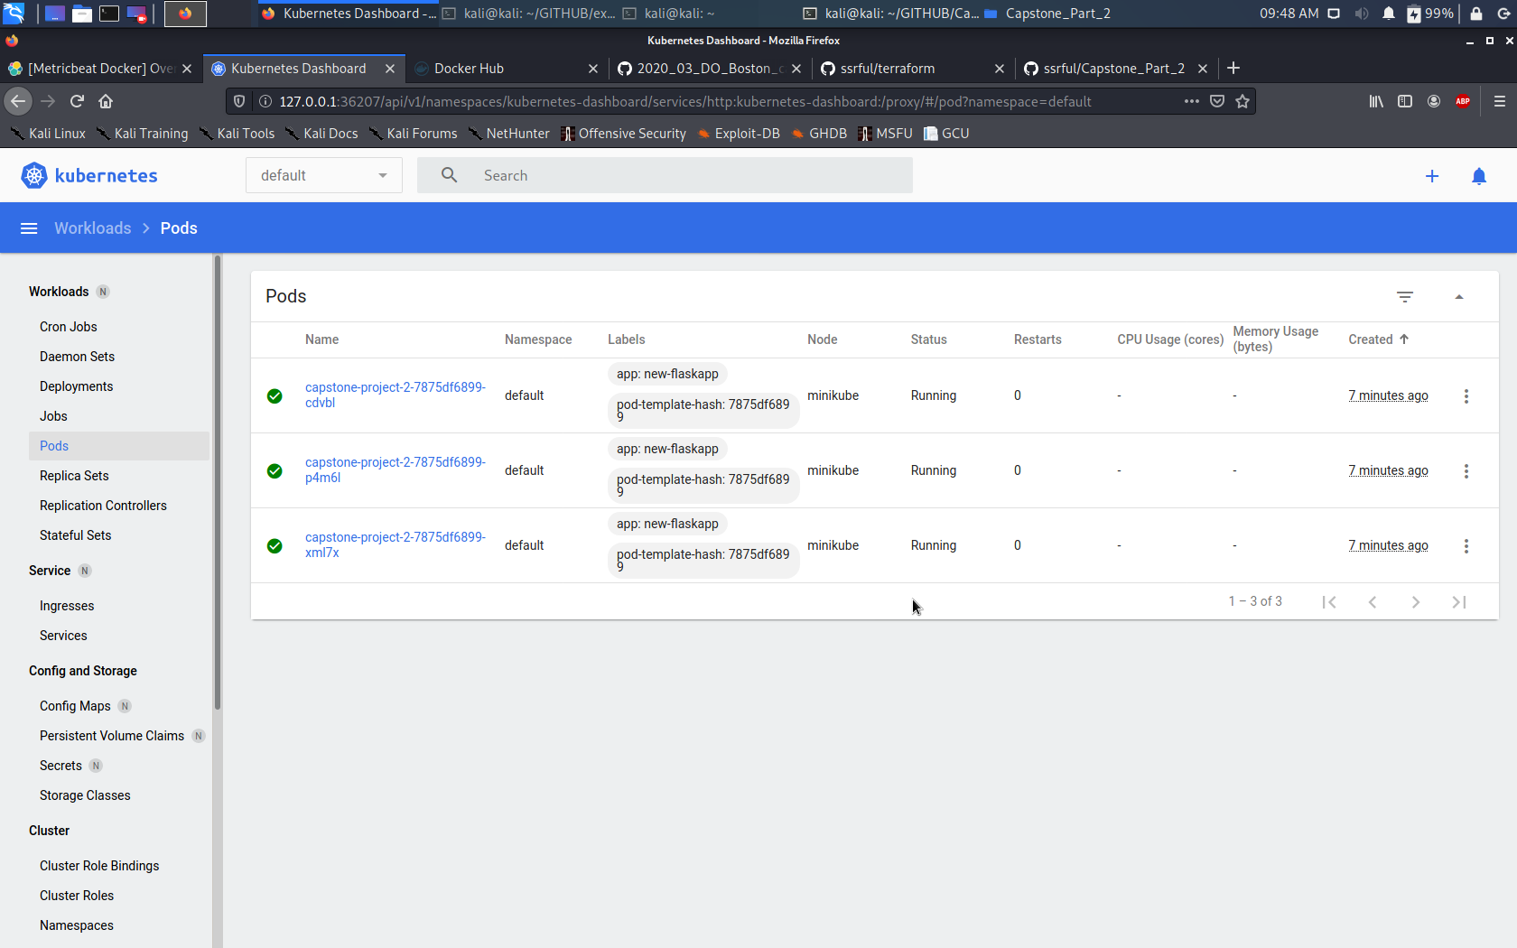

Slide 10
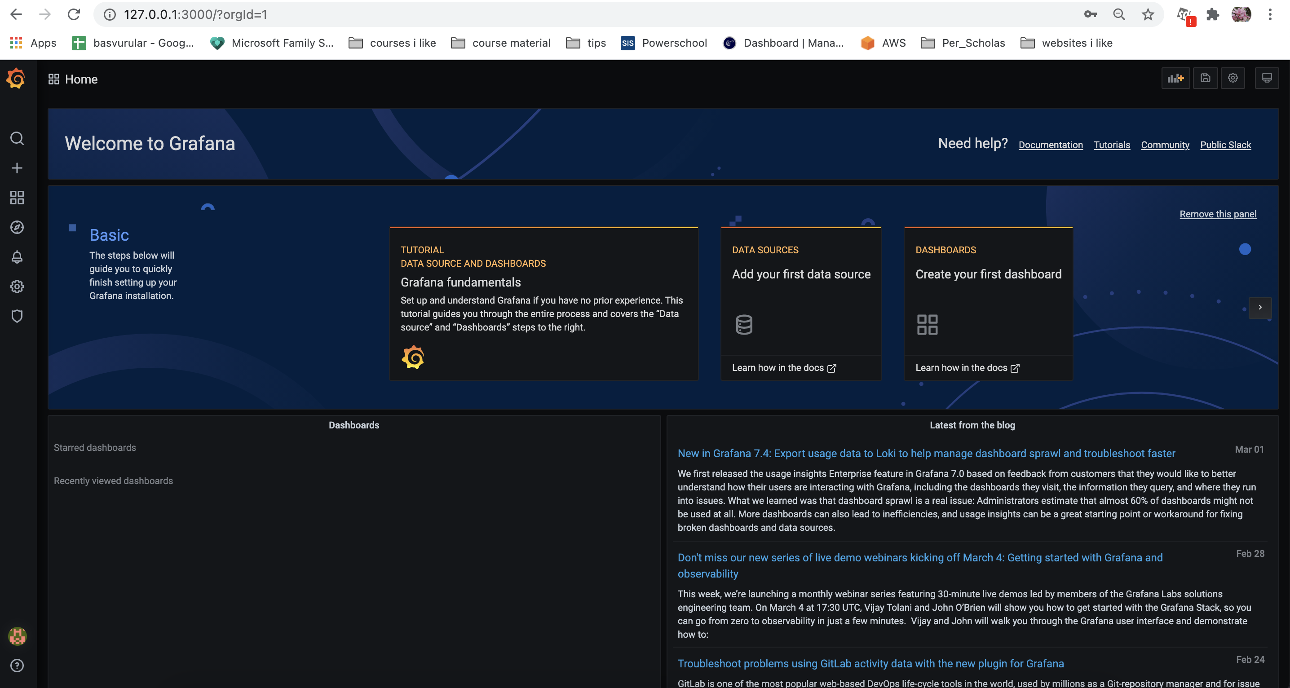

Slide 11
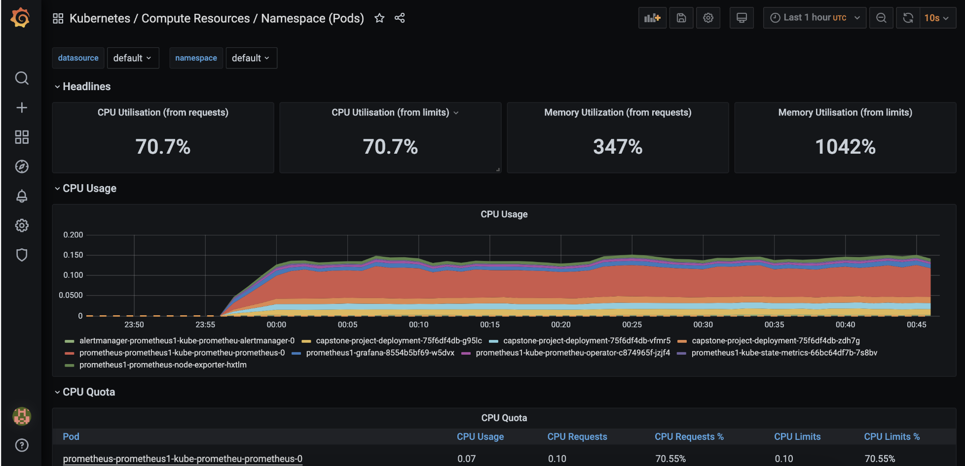
Grafana monitoring Kubernetes pods

Slide 12
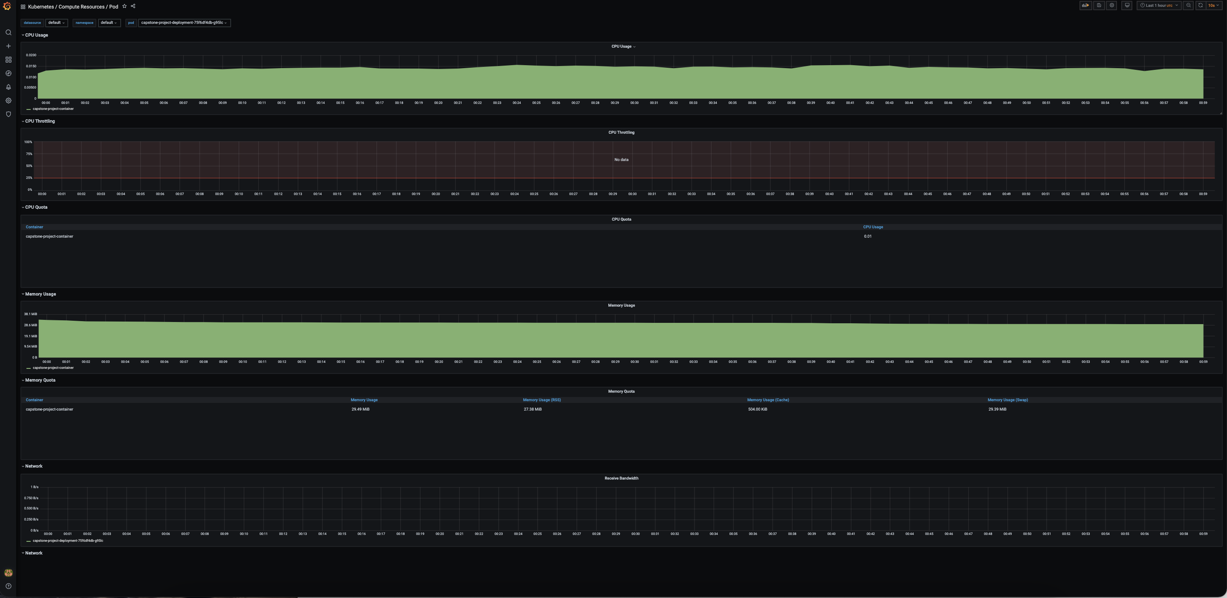
Grafana monitoring Kubernetes pods

Slide 13
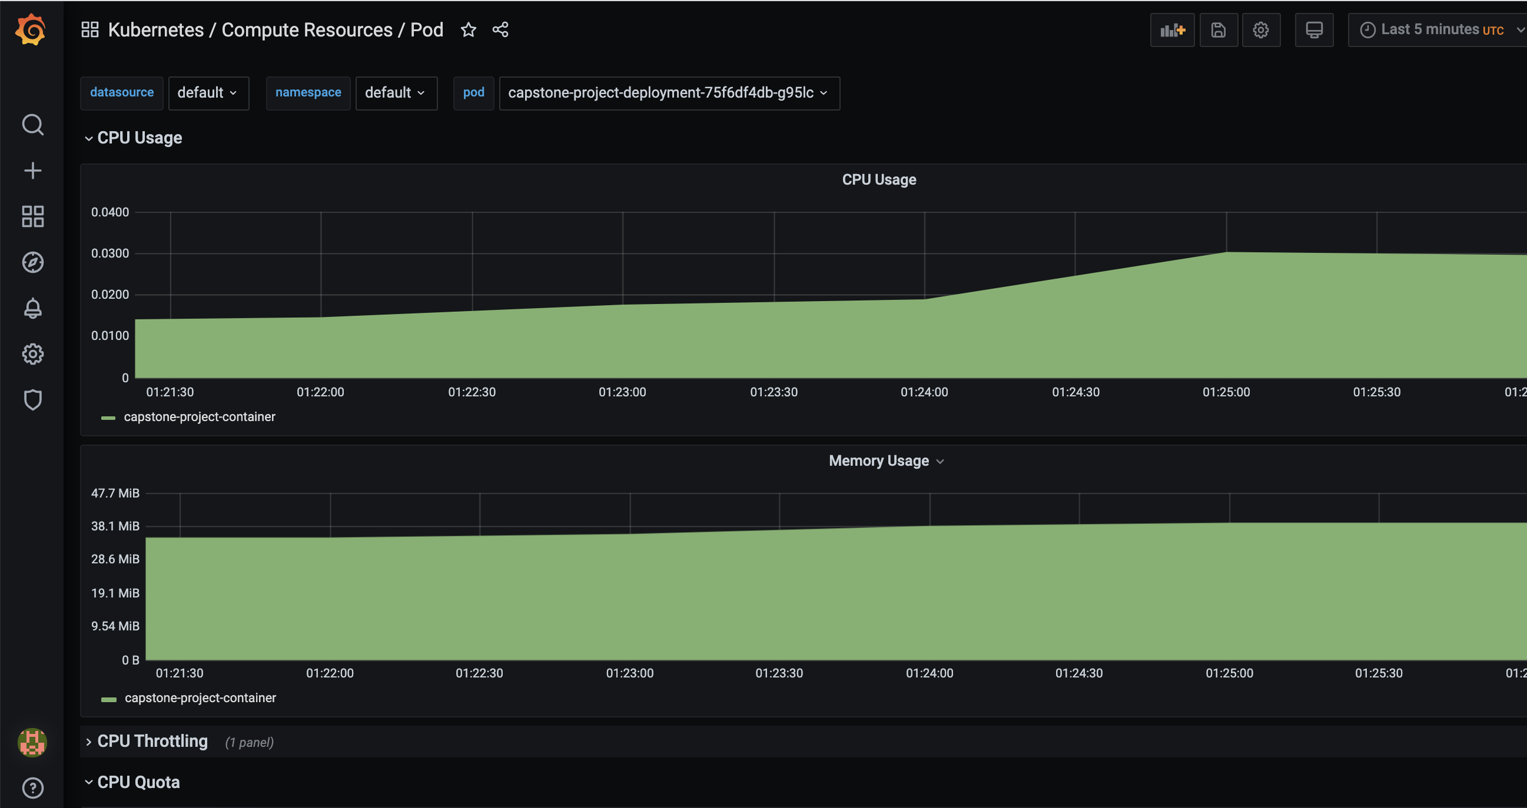
Grafana monitoring Kubernetes pods

Slide 14
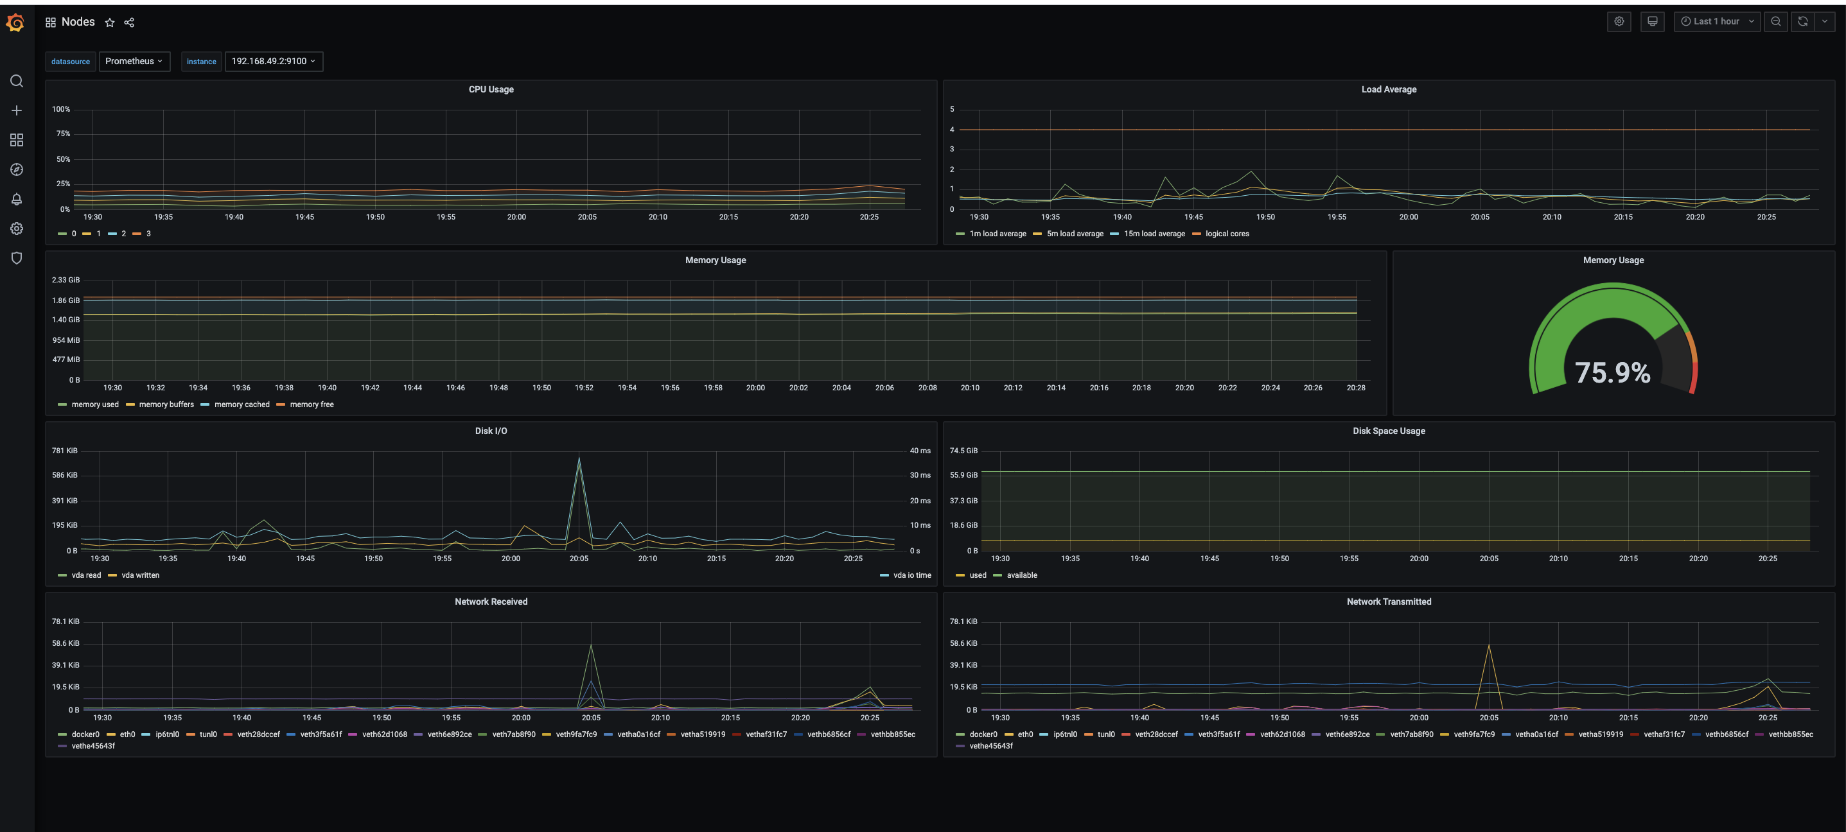
Grafana monitoring Kubernetes pods

Slide 15
Grafana monitoring Kubernetes pods

Slide 16
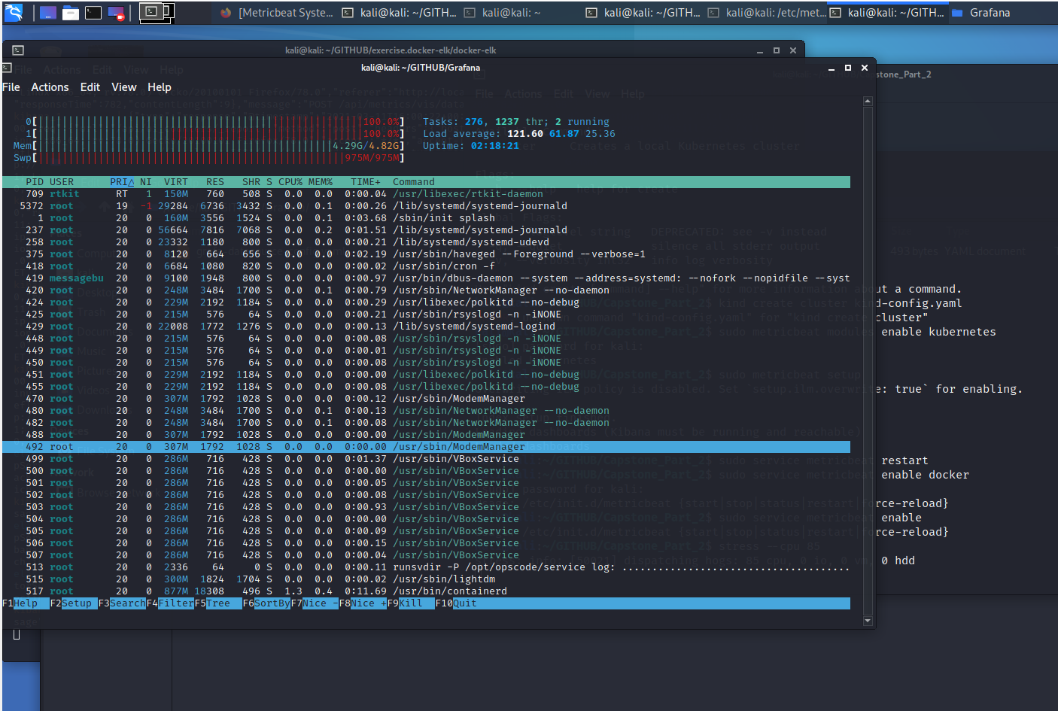
Stress test
On kali Linux

Slide 17
challenges
Ansible
• My VM keep bugging me with Ansible.
• Since, Ansible is currently an issue for me, I couldn’t run Playbook in Jenkins

Slide 18
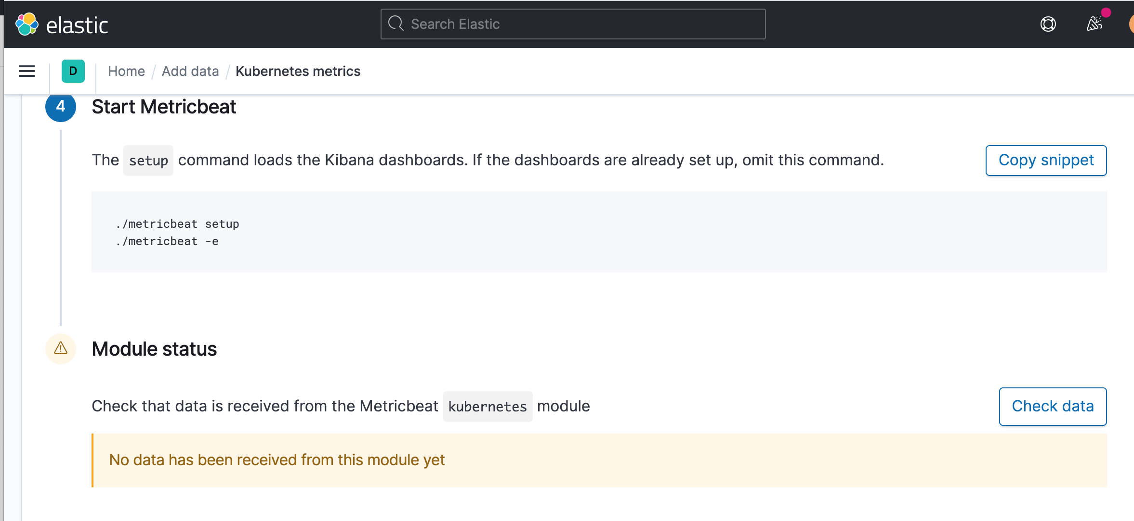
challenges
ELK Metricbeat and kubernetes
• Enabling the Metricbeat Dashboard for Docker was quite easy task, which is absolutely a vice versa with Metricbeat for Kubernetes

Slide 19
What should be achieved in nearly future?
• elk stack/metricbeat for Kubernetes
• implement in cloud: aws, azure or google cloud
Figure out a way to make it ELK metrics work with Kubernetes.
Figure out a way how to set up Chef and Ansible on my Host/VM’s as this is still an issue

Slide 20
Thank you for your attention

